Slide 1
Surveillance Tracking System using IoT
Internet of Talents
Christopher Beckett (CB)
Fiona Lin (FL)
Truong Xuan Nguyen (TN)

Slide 2
Project Background | Problem Statement
The use of private security has been exploding in Australia, with increased demand comes increased cost.
Conventional alarm and surveillance systems are fixed in place, and are not able to adapt to changing environments. This requires the use of private security officers.
With the majority of private security officers paid between $600-799/week ¹. Increasing the effective coverage area of each officer stands to drive major savings.
1 - Private security in Australia: trends and key characteristics.

Slide 3
Project Background | Scenario
ACME events is hosting a large scale outdoor art exhibit, at multiple locations throughout Australia.
At each location 15 art installations are set up on beaches approximately 50-100m apart from each other. Each art installation is quite expensive and fragile, requiring supervision throughout the night.
Due to the distance, several private security officers would be required to maintain adequate coverage of the installations. Conventional alarm and surveillance systems would require laborious and costly installation and setup at each new location.

Slide 4
Project Background | Benefits of IoT Approach
Traditional surveillance systems, suffer from problems:
They are fixed in place.
They are resource intensive, requiring:
Cameras, including expensive low light sensors
Cabling
A surveillance tracking system using IoT aims to be:
Highly accurate, allowing less human oversight
Portable, allowing it to monitor changing locations
Without the need for expensive vision systems

Slide 5
Project Outline | Scenario
A simple wireless surveillance system built on IoT principles would allow for rapid deployment of sensor nodes around each art installation, and centralised monitoring.
Allowing a smaller number of private security officers to monitor the exhibit from commodity cell phones.
Additionally, due the the rapid deployment, the sensor nodes could be removed during the exhibits opening times, allowing better viewing of the installation.
Both of these benefits wouldn’t be possible with a conventional surveillance system.

Slide 6
Project Outline | Objectives
Design and prototype a surveillance system passively track a single human moving through its monitored space (a classroom sized space).
Evaluate the pros and cons in comparison with other traditional fixed active surveillance systems.
Notify and present the tracking movements vividly to end users

Slide 7
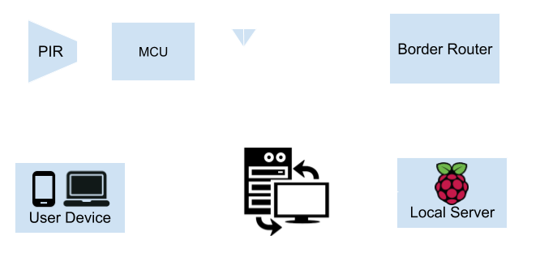
Project Outline | System Architecture

Slide 8
Project Outline | System Testing
Unit testing break into process listing below:
Sensor block detecting objects
Local server receive, validate and store sensor data
Central server object detection/location algorithm
Central server push notification of object detection
Graphical representation showing object location
Integration testing:
Sensor blocks and local server integration
Local server and central server integration
Central server push notification and user devices integration

Slide 9
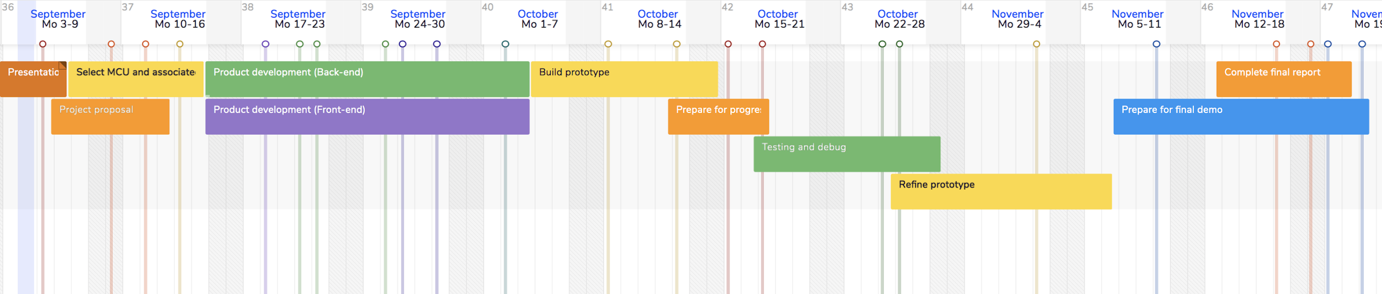
Project Plan | Overview
For interactive version, click here
Week 7
Week 8
Week 9
Week 10
Week 11
Week 12
Week 13
Week 14
Week 15
Week 16
Week 17 + 18

Slide 10
Project Plan | Key Milestones
Select and obtain all hardware | Week 08 | TN
Decide on wireless communications protocol | Week 09 | CB + FL
Build first sensor block | Week 09 | TN
Server ready to receive, aggregate and present data | Week 10 | CB + FL
Backend - Frontend integration | Week 10 | TN + CB
First prototype ready for initial deployment | Week 12 | TN + FL
Final prototype ready for deployment | Week 15 | TN + FL
Deploy final prototype to classroom environment | Week 16 | CB
Complete final report and final presentation | Week 18 | CB

